Slide 1

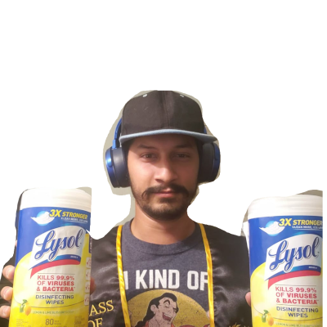
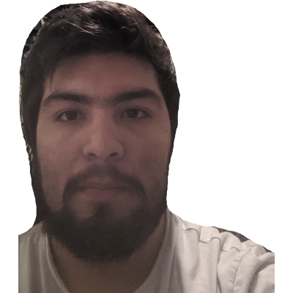
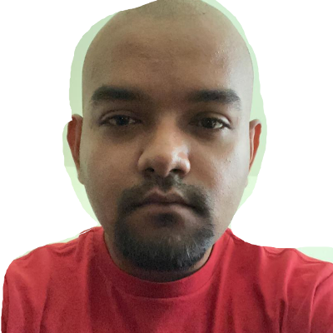

Sprint 7
(The Abridged Series)
Healthy Belly

Slide 2

Document Updates
Business Requirement Document: No major updates!
Management Plan
Updated Gantt Chart
Updated Burndown Chart
Updated Project Tracking Matrix
Updated Sprint Board
Notes:
Big Boi

Slide 3
User stories released this sprint
Completed:
Users should be able to see their information on the Profile Page
Users should be able to create an account
Users should be able to login
In progress user stories:
Users should be able to search for food
Users should be able to scan a barcode
Users should get feedback on the food item they scan
Notes:
Big Boi

Slide 4
Api and server
API
OpenFoodFacts
Server
Firebase
ODM Library
Firebase Firestore
Notes:
Hassan

Slide 5
Restructuring
Before we used a temporary local database to store login information
So we implemented firebase into our app
We had to restructure how we handled login and user profiles
Notes:
Josue

Slide 6
Refactoring
Since we implemented firebase we ended up refactoring a lot of code
The end result after refactoring was that we were able to reduce the amount of code for the login portion by over 50%
This has made our code way more efficient and easier to deal with.
Notes:
Josue

Slide 7
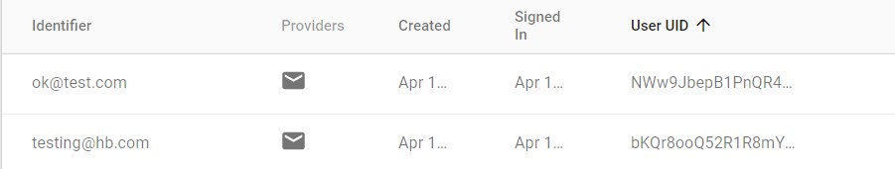
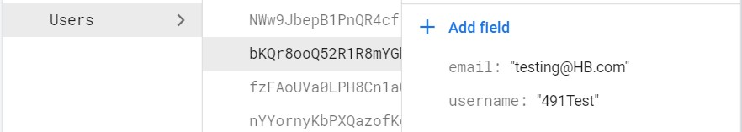
Login and profile data
Notes:
Mateo

Slide 8
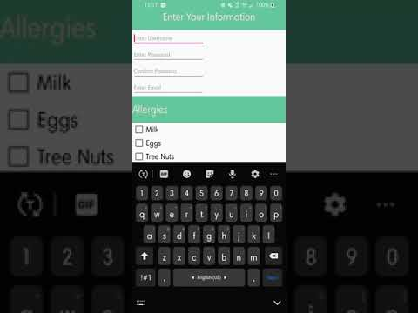
DEMO
Notes:
Mateo

Slide 9
Try our App
What do you need?
Android phone or an android phone virtual machine
Link:
https://drive.google.com/open?id=1gZDSGnTG11icvvA5vR-NIMlpMWycnQZ1
NOTE: MAKE YOUR PASSWORD MORE THAN 6 CHARACTERS LONG
Notes:
Mateo

Slide 10
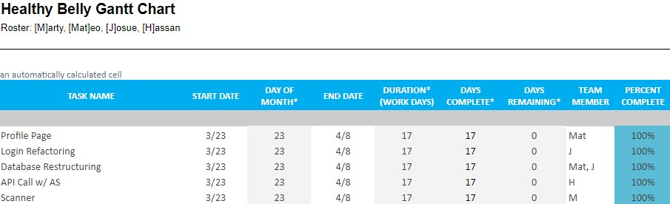
Gantt Chart
Notes:
Hassan

Slide 11
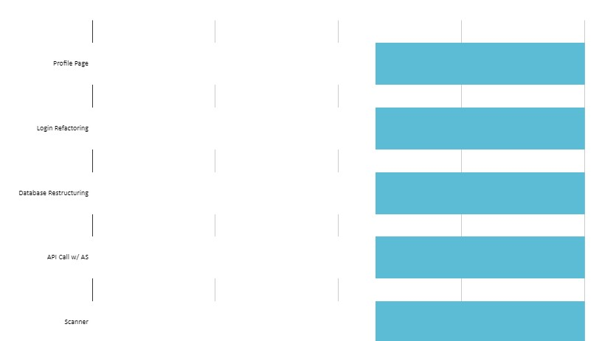
Gantt Chart
Notes:
Hassan

Slide 12
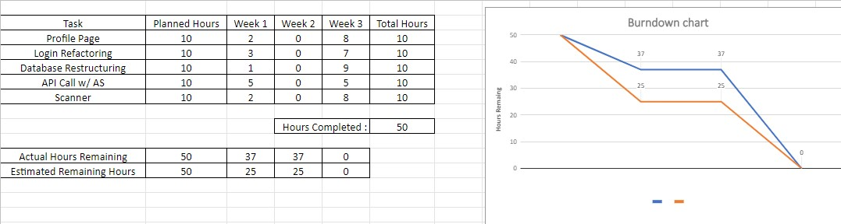
Burndown Chart
Notes:
Hassan

Slide 13
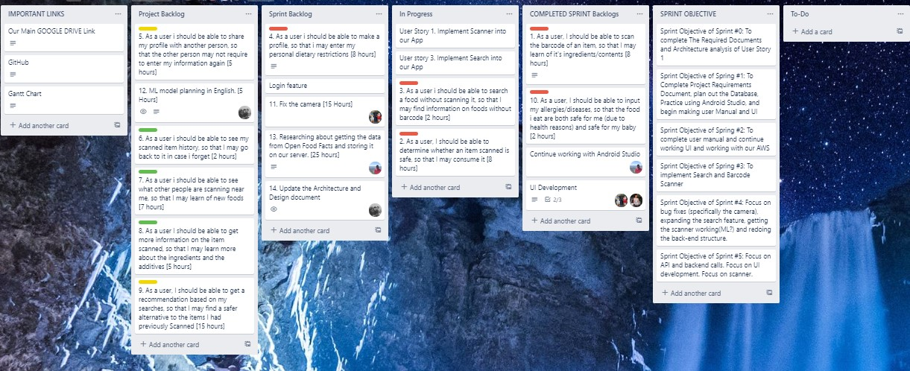
Sprint Board
Notes:
Hassan

Slide 14
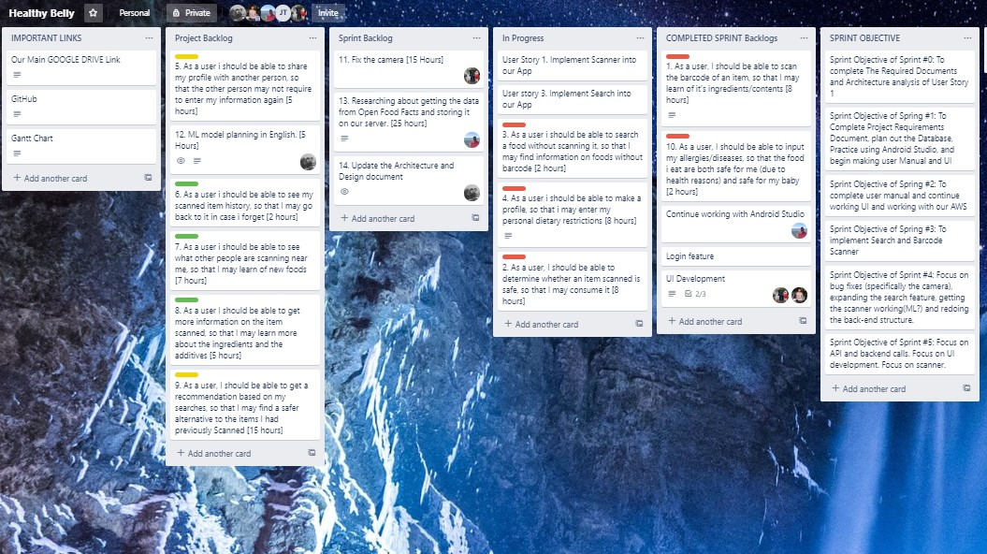
Sprint Board
Notes:
Hassan

Slide 15
Sprint Retrospective
GOALS
At this point we are focusing on getting a functional app
Might not be the prettiest, but we want it to work
50 Story points were planned and completed
Roadblocks
Working remotely, especially with software that some of us have never used (i.e. android studio, firebase) makes the process more difficult than it should be. Collaboration in person allows better understanding and explanation, and the inability to do it is costing us
Notes:
marty

Slide 16
What’s Next?
Polish up the UI
Finish Strong and put together the product so it is functional at the very least
Notes:
marty

